Slide 1
Parallel Port Programming -16x2 LCD Interfacing
Dr.Sreejith Rajan

Slide 2
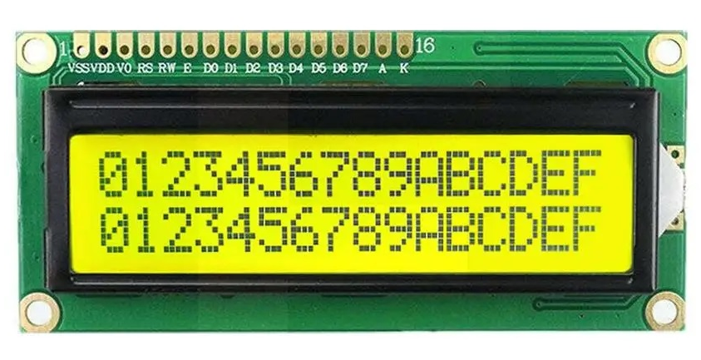
JHD-162
Popular LCD Module with 16 columns and 2 Rows
Controlled by HD44780 LCD Controller IC
1

Slide 3
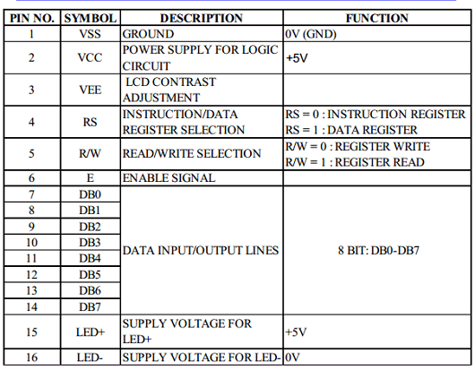
Pin Functions
1

Slide 4
HD44780 LCD Controller- Heart of the Module
The HD44780 is the internal controller chip inside many LCD modules (like JHD162A, 16×2 display).
It handles:
Character generation (5×8 or 5×10 pixel matrix per character)
Cursor and display control
Storing text in its own Display Data RAM (DDRAM)
1

Slide 5
Data Interface Modes
8-bit mode: Use D0–D7 (8 data lines)
4-bit mode: Use D4–D7 only (send high nibble, then low nibble)
Control pins:
RS – Register Select (0 = Command(Instruction), 1 = Data)
RW – Read/Write (0 = Write, 1 = Read; usually tied to GND)
E – Enable (a HIGH pulse latches data)
In our case: 4-bit mode, write-only (RW = GND)

Slide 6
Why 4-Bit Mode?
Saves 4 microcontroller pins (only D4–D7 used).
We send each byte in two parts (nibbles):
First, the upper nibble (bits 7–4)
Then the lower nibble (bits 3–0)

Slide 7
4 Bit Mode
After reset, the LCD always starts in 8-bit mode.
So before we can use 4-bit communication, we must tell the LCD to switch.

Slide 8
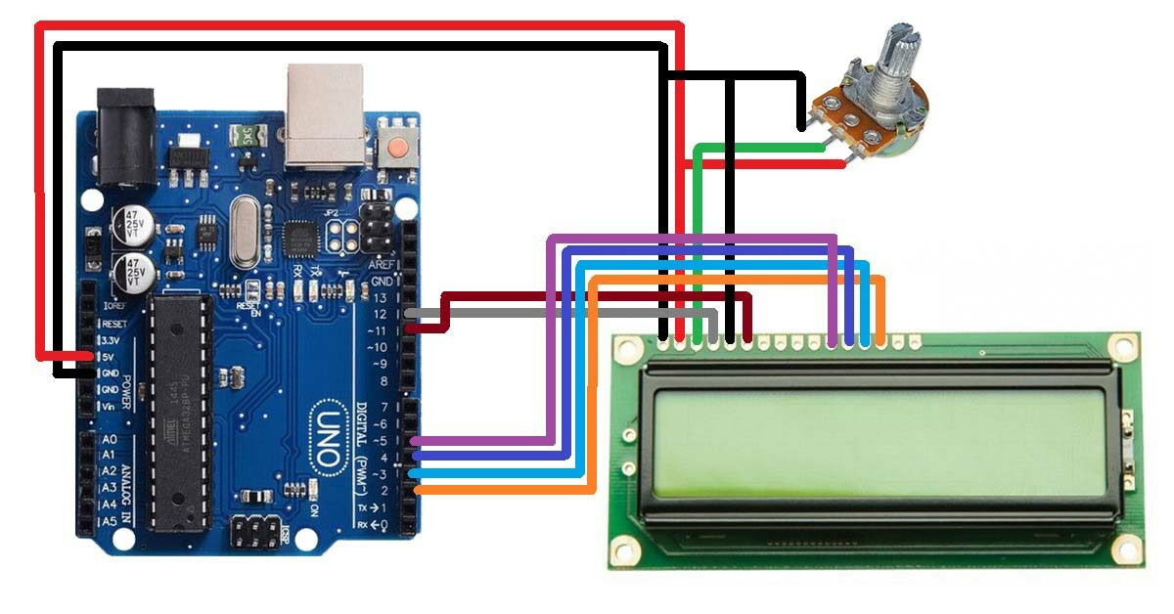
Interfacing 162A with Arduino

Slide 9
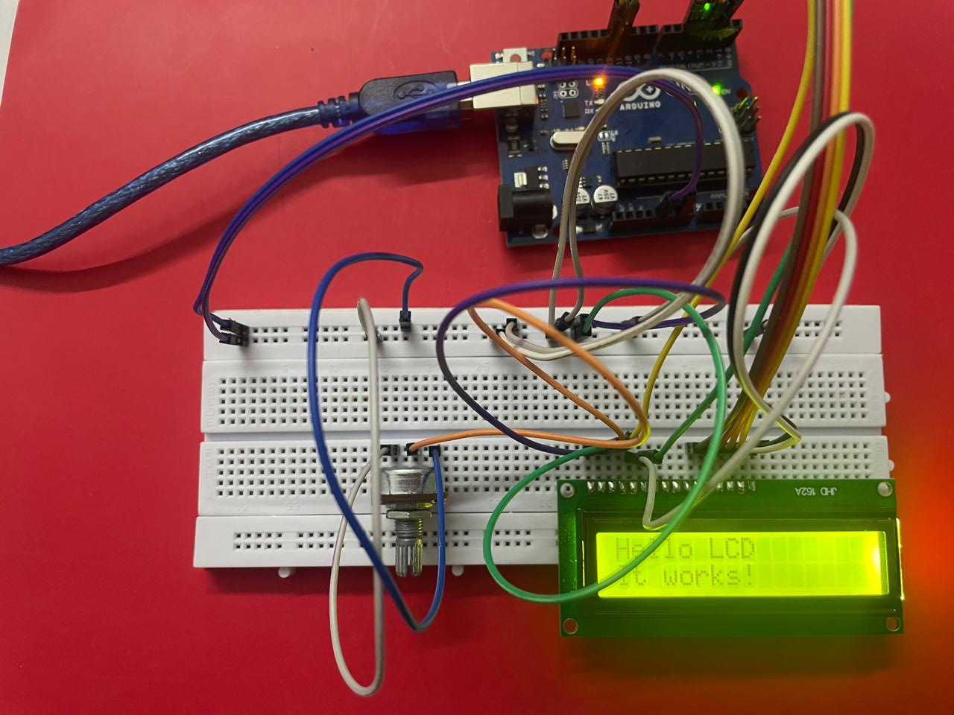
Interfacing 162A with Arduino

Slide 10
4 Bit Mode Initialisation sequence
Step | Command Sent | Hex | Purpose | Notes
1 | — | — | Wait > 15 ms after power ON | Allow LCD to stabilize
2 | Send upper nibble 0011 | 0x30 | Wake-up (8-bit mode) | via lcd_put_nibble(0x03)
3 | Send upper nibble 0011 | 0x30 | Repeat (8-bit) | Wait > 4 ms
4 | Send upper nibble 0011 | 0x30 | Repeat again | Wait > 100 µs
5 | Send upper nibble 0010 | 0x20 | ✅ Enter 4-bit mode | LCD now expects 4-bit data transfers

Slide 11
4 Bit Mode Initialisation sequence
Step | Command Sent | Hex | Purpose | Notes
6 | Function Set | 0x28 | 4-bit, 2 lines, 5×8 font | Confirms interface settings
7 | Display OFF | 0x08 | Turn display off | Safe before clearing
8 | Clear Display | 0x01 | Clear screen, reset cursor | Wait > 1.5 ms
9 | Entry Mode Set | 0x06 | Auto-increment cursor (left→right) | Normal text entry
10 | Display ON | 0x0C | Display ON, cursor OFF, blink OFF | Ready to display text ✅

Slide 12
Key Commands after Initialisation
Command | Hex | Function | Delay
Clear Display | 0x01 | Erase & move cursor home | 1.6 ms
Return Home | 0x02 | Cursor → position 0 | 1.6 ms
Entry Mode Set | 0x06 | Cursor moves right | 37 µs
Display ON/OFF | 0x0C | Display ON, cursor OFF | 37 µs
Function Set | 0x28 | 4-bit, 2-line, 5×8 font | 37 µs
Set DDRAM Address | 0x80 + addr | Move cursor | 37 µs
1

Slide 13
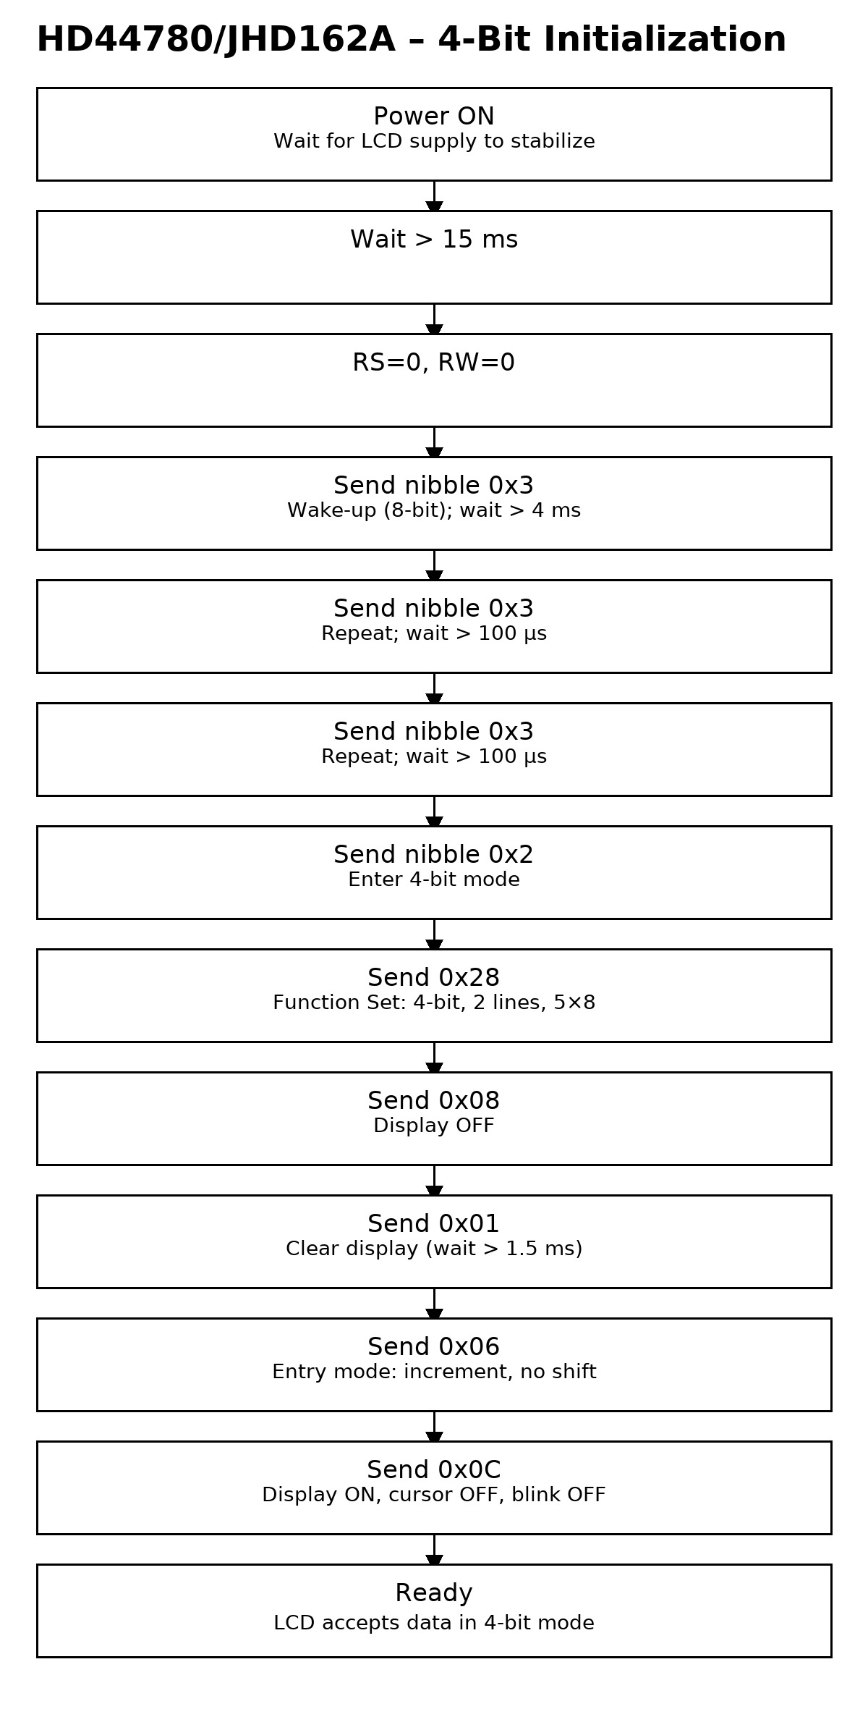
Flow Charts -Initialisation
1

Slide 14
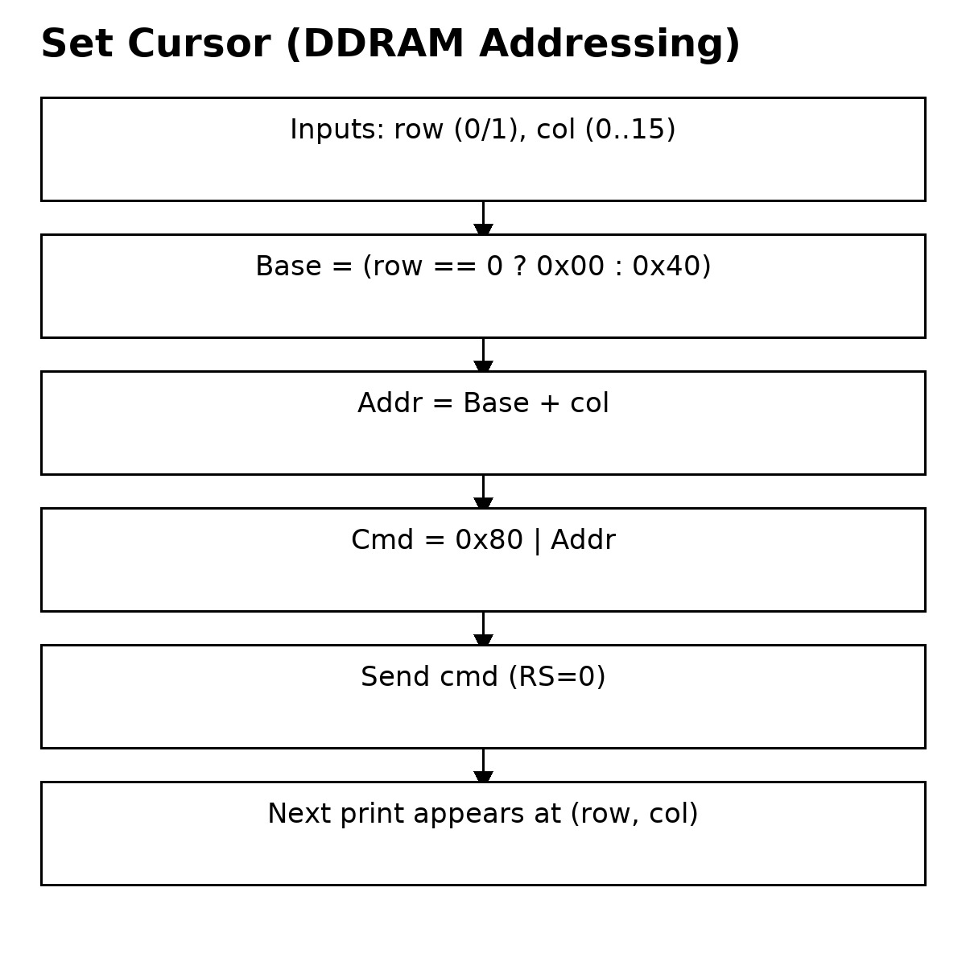
Flow Charts –Set Cursor
1

Slide 15
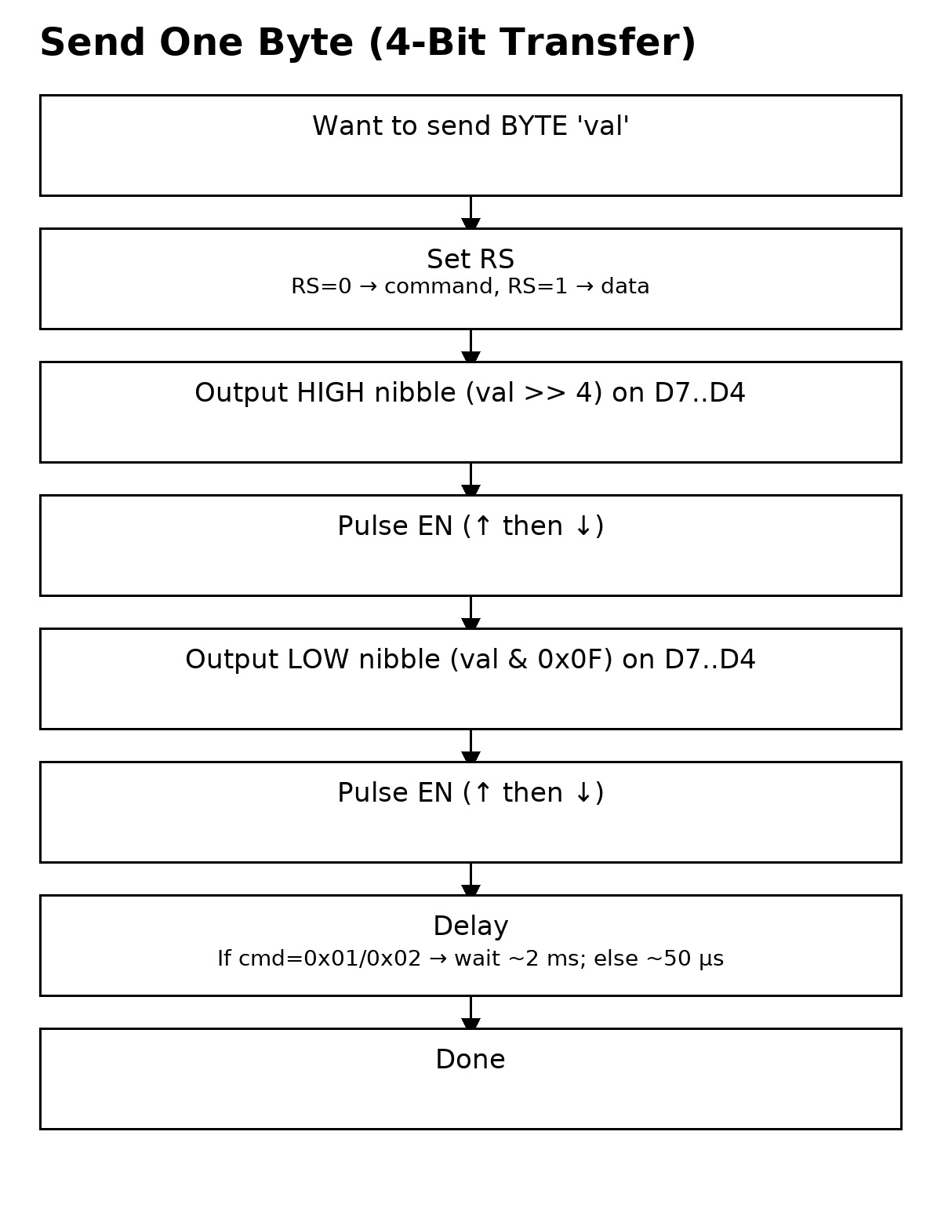
Flow Charts –Send Byte
1

Slide 16
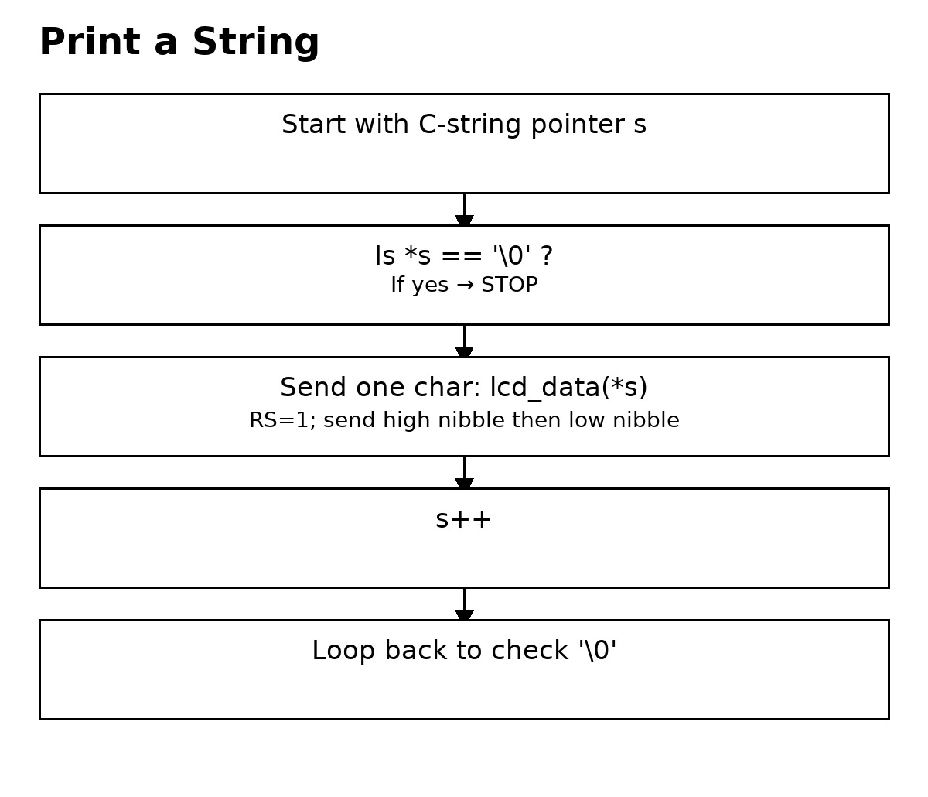
Flow Charts –Print String
1

Slide 17
THANK YOU

